Slide 1
CSE 205: Digital Logic Design
Prepared By,
Dr. Tanzima Hashem, Assistant Professor, CSE, BUET
Updated By,
Fatema Tuz Zohora, Lecturer, CSE, BUET

Slide 2
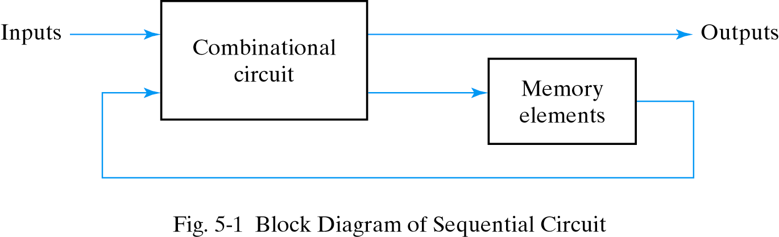
Sequential Circuits
Consist of a combinational circuit to which storage elements are connected to form a feedback path
State:  the state of the memory devices now, also called current state
Next states and outputs are functions of inputs and present states of storage elements

Slide 3
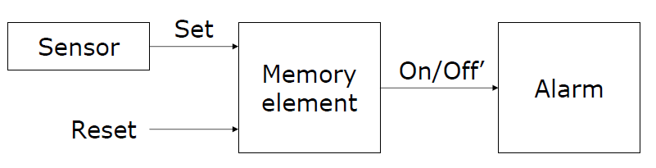
Alarm control system
Suppose we wish to construct an alarm circuit such that the output remains active (on) even after the sensor output that triggered the alarm goes off
The circuit requires a memory element to remember that the alarm has to be active until a reset signal arrives

Slide 4
Two Types of Sequential Circuits
Asynchronous sequential circuit
Depends upon the input signals at any instant of time and their change order
May have better performance but hard to design
Synchronous sequential circuit
Defined from the knowledge of its signals at discrete instants of time
Much easier to design (preferred design style)
Synchronized by a periodic train of clock pulses

Slide 5
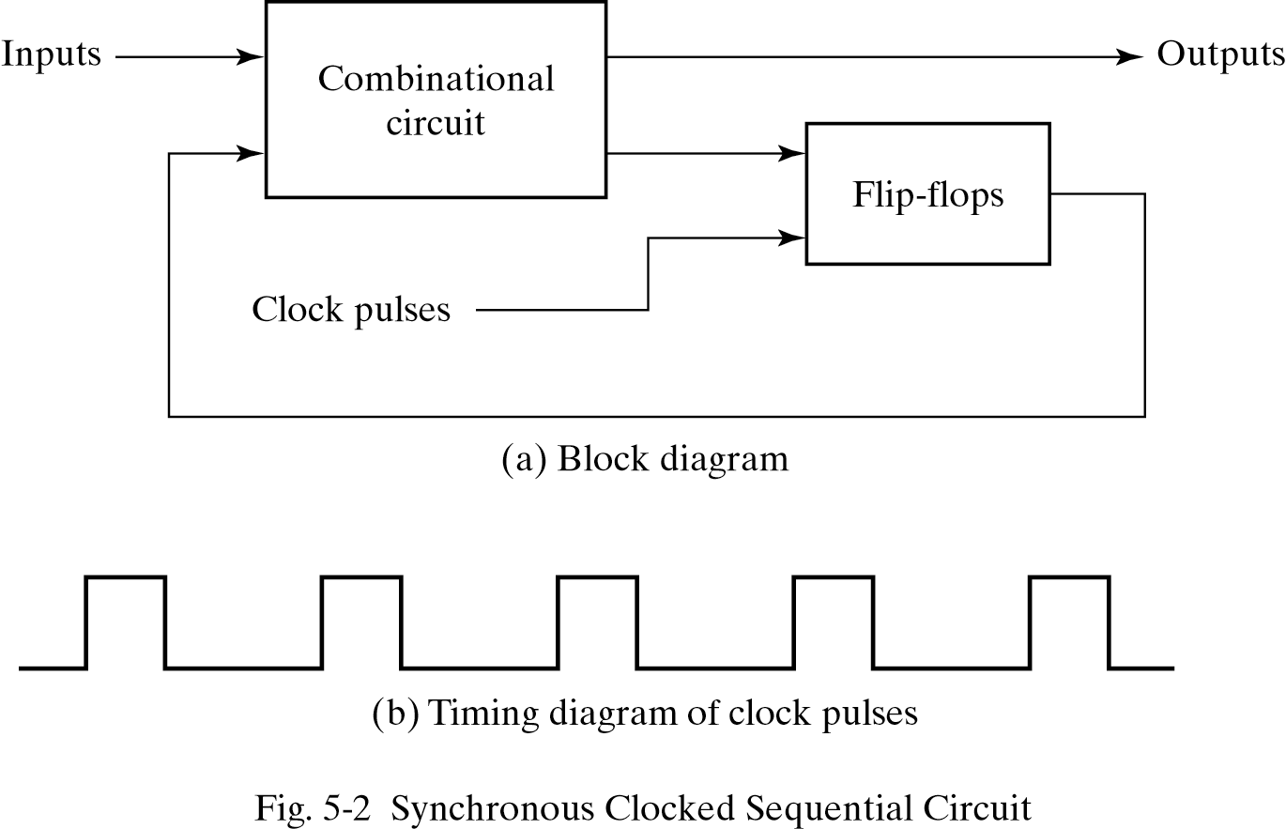
Synchronous Sequential Circuits

Slide 6
Memory elements
Latch - a level-sensitive memory element
SR latches
D latches
Flip-Flop - an edge-triggered memory element
Master-slave flip-flop
Edge-triggered flip-flop
RAM and ROM  a mass memory element
C
CLK
Positive Edge
CLK
Negative Edge

Slide 7
Latches
A latch is binary storage element
Can store a 0 or 1
The most basic memory
Easy to build
Built with gates (NORs, NANDs, NOT)

Slide 8
Latches
S R Q₀ | Q | Q’
0 0 0
SR Latch
0 | 1
Q = Q₀
0
0
0
1
Initial Value

Slide 9
Latches
S R Q₀ | Q | Q’
0 0 0 | 0 | 1
0 0 1
SR Latch
Q = Q₀
1 | 0
Q = Q₀
0
1
0
0

Slide 10
Latches
S R Q₀ | Q | Q’
0 0 0 | 0 | 1
0 0 1 | 1 | 0
0 1 0 | 0
SR Latch
Q = Q₀
1
 | 1
Q = 0
0
0
1

Slide 11
Latches
S R Q₀ | Q | Q’
0 0 0 | 0 | 1
0 0 1 | 1 | 0
0 1 0 | 0 | 1
0 1 1
SR Latch
Q = Q₀
1
Q = 0
1
0 | 1
Q = 0
0
0

Slide 12
Latches
S R Q₀ | Q | Q’
0 0 0 | 0 | 1
0 0 1 | 1 | 0
0 1 0 | 0 | 1
0 1 1 | 0 | 1
1 0 0
SR Latch
Q = Q₀
0
0
Q = 0
1 | 0
Q = 1
1
1

Slide 13
Latches
S R Q₀ | Q | Q’
0 0 0 | 0 | 1
0 0 1 | 1 | 0
0 1 0 | 0 | 1
0 1 1 | 0 | 1
1 0 0 | 1 | 0
1 0 1
SR Latch
Q = Q₀
0
1
Q = 0
Q = 1
1 | 0
Q = 1
1
0

Slide 14
Latches
S R Q₀ | Q | Q’
0 0 0 | 0 | 1
0 0 1 | 1 | 0
0 1 0 | 0 | 1
0 1 1 | 0 | 1
1 0 0 | 1 | 0
1 0 1 | 1 | 0
1 1 0
SR Latch
Q = Q₀
1
0
Q = 0
Q = 1
0 | 0
Q = Q’
1
1
0

Slide 15
Latches
S R Q₀ | Q | Q’
0 0 0 | 0 | 1
0 0 1 | 1 | 0
0 1 0 | 0 | 1
0 1 1 | 0 | 1
1 0 0 | 1 | 0
1 0 1 | 1 | 0
1 1 0 | 0 | 0
1 1 1
SR Latch
Q = Q₀
1
1
Q = 0
0
Q = 1
Q = Q’
0 | 0
Q = Q’
1
0

Slide 16
SR Latch
S R | Q
0 0 | Q₀
0 1 | 0
1 0 | 1
1 1 | Q=Q’=0
No change
Reset
Set
Invalid
S R | Q
0 0 | Q=Q’=1
0 1 | 1
1 0 | 0
1 1 | Q₀
Invalid
Set
Reset
No change

Slide 17
SR Latch
S R | Q
0 0 | Q₀
0 1 | 0
1 0 | 1
1 1 | Q=Q’=0
No change
Reset
Set
Invalid
S’ R’ | Q
0 0 | Q=Q’=1
0 1 | 1
1 0 | 0
1 1 | Q₀
Invalid
Set
Reset
No change

Slide 18
Controlled Latches
SR Latch with Control Input
C S R | Q
0 x x | Q₀
1 0 0 | Q₀
1 0 1 | 0
1 1 0 | 1
1 1 1 | Q=Q’
No change
No change
Reset
Set
Invalid

Slide 19
Controlled Latches
Timing Diagram
D Latch (D = Data)
C
D
Q
t
C D | Q
0 x | Q₀
1 0 | 0
1 1 | 1
Output may change
No change
Reset
Set

Slide 20
Controlled Latches
Timing Diagram
D Latch (D = Data)
C
D
Q
C D | Q
0 x | Q₀
1 0 | 0
1 1 | 1
Output may change
No change
Reset
Set

Slide 21
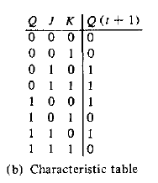
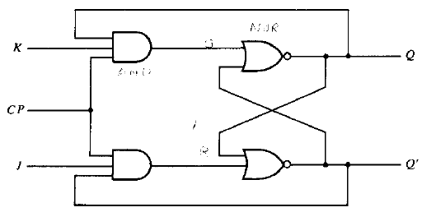
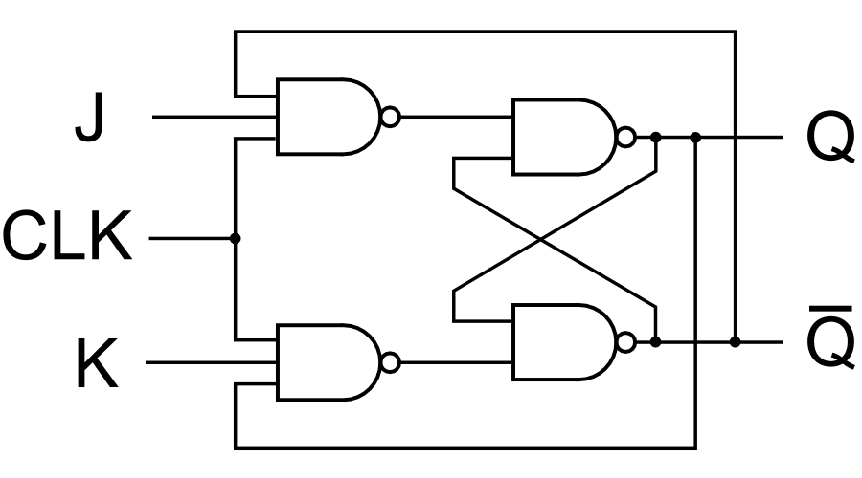
Controlled Latches
JK Latch

Slide 22
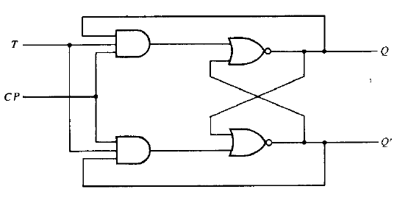
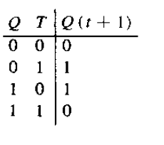
Controlled Latches
T - Latch

Slide 23
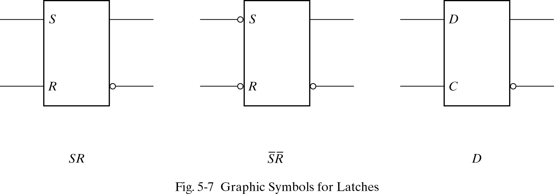
Graphic symbols for latches

Slide 24
Level versus edge sensitivity
Since the output of the D latch is controlled by the level (0 or 1) of the clock input, thelatch is said to be level sensitive
All of the latches we have seen have been level sensitive
It is possible to design a storage element for which the output only changes a the point in time when the clock changes from one value to another
Such circuits are said to be edge triggered

Slide 25
Flip-Flops
Controlled latches are level-triggered
Flip-Flops are edge-triggered
C
CLK
Positive Edge
CLK
Negative Edge

Slide 26
Flip-Flops
Three SR Latch
Edge-Triggered D Flip-Flop (positive edge triggered)
D
Q
Q
Positive Edge
D
Q
Q
Negative Edge

Slide 27
Flip-Flops
No change in output
Edge-Triggered D Flip-Flop
1
0
S R | Q
0 0 | Q=Q’=1
0 1 | 1
1 0 | 0
1 1 | Q₀
Invalid
Set
Reset
No
change
1
0

Slide 28
Flip-Flops
No change in output
Edge-Triggered D Flip-Flop
1
0
S R | Q
0 0 | Q=Q’=1
0 1 | 1
1 0 | 0
1 1 | Q₀
Invalid
Set
Reset
No
change
1
1

Slide 29
Flip-Flops
If D = 0 when CLK
turns from 0 to 1,
R → 0, Q = 0
Edge-Triggered D Flip-Flop
1
0
Reset State
1
1
S R | Q
0 0 | Q=Q’=1
0 1 | 1
1 0 | 0
1 1 | Q₀
Invalid
Set
Reset
No
change
1
0
1
1
1
0

Slide 30
Flip-Flops
After reaching Reset State, while CLK = 1, what happens if
D changes to 1?
Edge-Triggered D Flip-Flop
1
0
Reset State
1
1
S R | Q
0 0 | Q=Q’=1
0 1 | 1
1 0 | 0
1 1 | Q₀
Invalid
Set
Reset
No
change
0
1
1
0

Slide 31
Flip-Flops
If D = 1 when CLK
turns from 0 to 1,
R → 0, Q = 0
Edge-Triggered D Flip-Flop
0
1
Set State
0
1
1
S R | Q
0 0 | Q=Q’=1
0 1 | 1
1 0 | 0
1 1 | Q₀
Invalid
Set
Reset
No
change
0
1
0
0
1

Slide 32
Flip-Flops
After reaching Set State, while CLK = 1, what happens if
D changes to 0?
Edge-Triggered D Flip-Flop
0
1
Set State
0
1
S R | Q
0 0 | Q=Q’=1
0 1 | 1
1 0 | 0
1 1 | Q₀
Invalid
Set
Reset
No
change
1
0
0
1

Slide 33
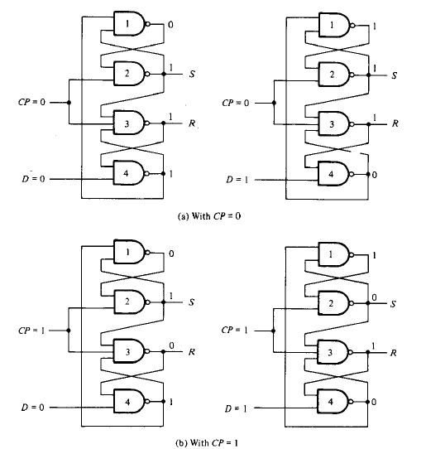
Flip-Flops: Edge-Triggered D Flip-Flop

Slide 34
Flip-Flops
If D = 0 when CLK turns from 0 to 1, R → 0, Q = 0: ‘reset state’
If D changes while CLK is high →flip-flop will not respond to the change.
When CLK turns from 1 to 0, Q = 0: , R → 1, flip-flop will be in the same state (no change in output).
If D = 1 when CLK from 0 to 1, S →0, Q = 1: ‘set state’

Slide 35
Flip-Flops
JK Flip-Flop
J
Q
D = JQ’ + K’Q
K
Q

Slide 36
Flip-Flops
JK Flip-Flop
When J = 1 and K = 0, D = 1 → next clock edge sets output to 1.
D = JQ’ + K’Q

Slide 37
Flip-Flops
JK Flip-Flop
When J = 0 and K = 1, D = 0 → next clock edge resets output to 0.
D = JQ’ + K’Q

Slide 38
Flip-Flops
JK Flip-Flop
When J = 1 and K = 1, D= Q’ → next clock edge complements output.
D = JQ’ + K’Q

Slide 39
Flip-Flops
T Flip-Flop
T
J
Q
T
D
Q
Q
K
Q
T
Q
D = JQ’ + K’Q
D = TQ’ + T’Q = T ⊕ Q
Q

Slide 40
Master-Slave Flip-Flops
Master-Slave D Flip-Flop (negative edge triggered)
D Latch
(Master)
D Latch
(Slave)
D
D
C
Q
D
C
Q
Q
Master
Slave
CLK
CLK
D
Looks like it is negative edge-triggered
Q_{Master}
Q_{Slave}

Slide 41
Master-Slave Flip-Flops
The circuit samples the D input and changes its output at the negative edge of the clock, CLK.
When the clock is 0, the output of the inverter is 1. The slave latch is enabled and its output Q is equal to the master output Y. The master latch is disabled (CLK = 0).
When the CLK changes to high, D input is transferred to the master latch. The slave remains disabled as long as CLK is low. Any change in the input changes Y,but not Q.
The output of the flip-flop can change when CLK makes a transition 1 → 0

Slide 42
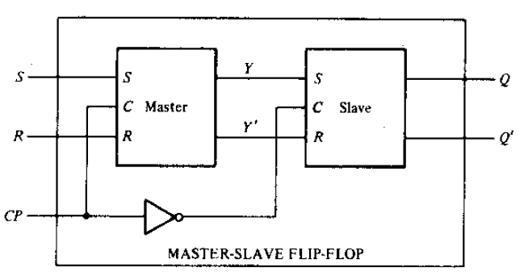
Master-Slave Flip-Flops
Master Slave SR Flip-Flop (negative edge triggered)

Slide 43
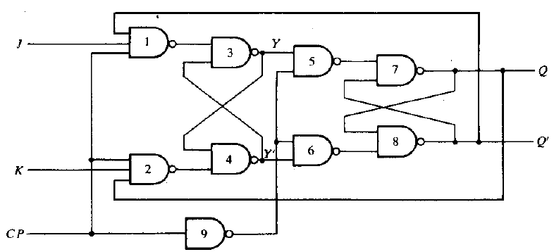
Master-Slave Flip-Flops
Master Slave JK Flip-Flop (negative edge triggered)

Slide 44
Flip-Flop Characteristic Tables
D | Q(t+1)
0 | 0
1 | 1
D
Q
Reset
Set
Q
J | K | Q(t+1)
0 | 0 | Q(t)
0 | 1 | 0
1 | 0 | 1
1 | 1 | Q’(t)
J
Q
No change
Reset
Set
Toggle
K
Q
T
Q
T | Q(t+1)
0 | Q(t)
1 | Q’(t)
No change
Toggle
Q

Slide 45
Flip-Flop Characteristic Equations
D | Q(t+1)
0 | 0
1 | 1
D
Q
Q(t+1) = D
Q
J | K | Q(t+1)
0 | 0 | Q(t)
0 | 1 | 0
1 | 0 | 1
1 | 1 | Q’(t)
J
Q
Q(t+1) = JQ’ + K’Q
K
Q
T
Q
T | Q(t+1)
0 | Q(t)
1 | Q’(t)
Q(t+1) = T ⊕ Q
Q

Slide 46
Flip-Flops with Direct Inputs
Asynchronous Reset
R’ | D | CLK | Q(t+1)
0 | x | x | 0
1 | 0 | ↑ | 0
1 | 1 | ↑ | 1
D
Q
Q
R
Reset

Slide 47
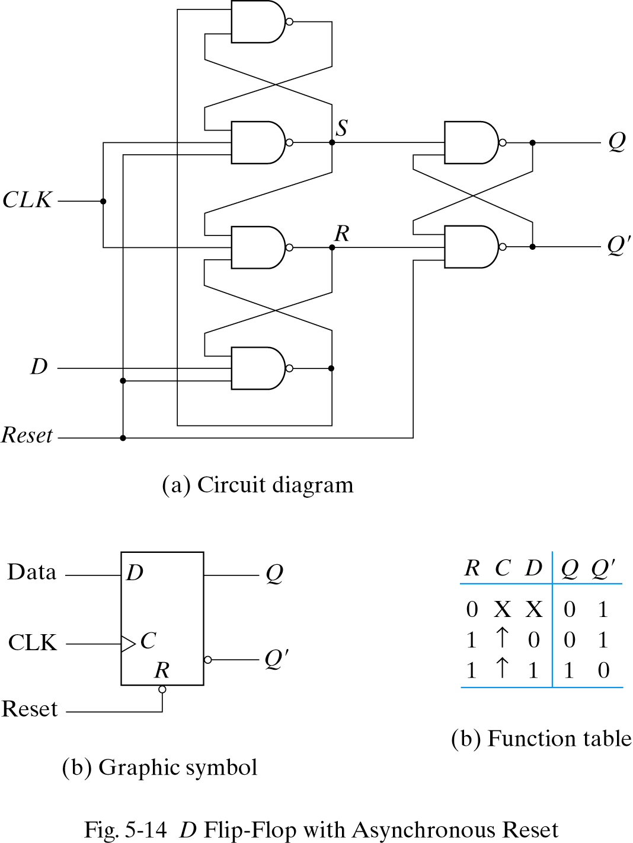
Flip-Flops with Direct Inputs
1
0
0
1
Asynchronous Reset
Connect the Reset
Input such that
Reset=0 will
immediately make
Q=0 (Reset state)
0
1
0
1
0

Slide 48
Flip-Flops with Direct Inputs
Asynchronous Preset and Clear
Preset
PR’ | CLR’ | D | CLK | Q(t+1)
1 | 0 | x | x | 0
0 | 1 | x | x | 1
1 | 1 | 0 | ↑ | 0
1 | 1 | 1 | ↑ | 1
PR
D
Q
Q
CLR
Reset

Slide 49
Analysis of Clocked Sequential Circuits: The State
State = Values of all Flip-Flops
Example
A B = 0 0

Slide 50
Analysis of Clocked Sequential Circuits: Terminology
State Equation: A state equation (transition equation) specifies the next state as a function of the present state and inputs.
State Table: A state table (transition table) consists of: present state, input, next state and output.
State Diagram: The information in a state table can be represented graphically in a state diagram. The state is represented by a circle and the transitions between states are indicated by directed lines connecting the circles.

Slide 51
Analysis of Clocked Sequential Circuits: State/Transition Equations
Input Equation:
D_{A} = A(t)x(t) + B(t)x(t)
D_{B} = A’(t)x(t)
Output Equation:
y(t) = [A(t)+ B(t)] x’(t) = (A + B) x’
State Equation:
A(t+1) = D_{A} = A(t) x(t)+B(t) x(t) = A x + B x
B(t+1) = D_{B} = A’(t) x(t) = A’ x

Slide 52
Analysis of Clocked Sequential Circuits: State /Transition Table
Present State |  | Input | Next State |  | Output
A | B | x | A | B | y
0 | 0 | 0
0 | 0 | 1
0 | 1 | 0
0 | 1 | 1
1 | 0 | 0
1 | 0 | 1
1 | 1 | 0
1 | 1 | 1
0 0 0
0 1 0
0 0 1
1 1 0
0 0 1
1 0 0
0 0 1
1 0 0
A(t+1) = A x + B x
B(t+1) = A’ x
y(t) = (A + B) x’
t
t+1
t

Slide 53
Analysis of Clocked Sequential Circuits: State/Transition Table
Present State |  |  | Next State |  |  |  | Output
 |  |  | x = 0 |  | x = 1 |  | x = 0 | x = 1
A |  | B | A | B | A | B | y | y
0 |  | 0 | 0 | 0 | 0 | 1 | 0 | 0
0 |  | 1 | 0 | 0 | 1 | 1 | 1 | 0
1 |  | 0 | 0 | 0 | 1 | 0 | 1 | 0
1 |  | 1 | 0 | 0 | 1 | 0 | 1 | 0
t
t+1
t
A(t+1) = A x + B x
B(t+1) = A’ x
y(t) = (A + B) x’

Slide 54
Analysis of Clocked Sequential Circuits: State Diagram
Present State |  |  | Next State |  |  |  | Output
 |  |  | x = 0 |  | x = 1 |  | x = 0 | x = 1
A |  | B | A | B | A | B | y | y
0 |  | 0 | 0 | 0 | 0 | 1 | 0 | 0
0 |  | 1 | 0 | 0 | 1 | 1 | 1 | 0
1 |  | 0 | 0 | 0 | 1 | 0 | 1 | 0
1 |  | 1 | 0 | 0 | 1 | 0 | 1 | 0
AB
input/output
0/0
1/0
0/1
0 0
1 0
0/1
1/0
0/1
1/0
0 1
1 1
1/0

Slide 55
Analysis of Clocked Sequential Circuits: D Flip-Flops
Example:
No Output column / Output Equation (Output = Next State)
x
D
Q
A
y
Present State | Input |  | Next State
A | x | y | A
0 | 0 | 0
0 | 0 | 1
0 | 1 | 0
0 | 1 | 1
1 | 0 | 0
1 | 0 | 1
1 | 1 | 0
1 | 1 | 1
CLK
Q
Input Equation: D_{A} = A ⊕ x ⊕ y
0
1
1
0
1
0
0
1
State Equation: A(t+1) = D_{A} = A ⊕ x ⊕ y
01,10
0
1
00,11
00,11
01,10

Slide 56
Analysis of Clocked Sequential Circuits: JK Flip-Flops
Example:
Present State |  | I/P | Next State |  | Flip-Flop Inputs
A | B | x | A | B | J_{A} | K_{A} | J_{B} | K_{B}
0 | 0 | 0
0 | 0 | 1
0 | 1 | 0
0 | 1 | 1
1 | 0 | 0
1 | 0 | 1
1 | 1 | 0
1 | 1 | 1
0 1
0 0
1 1
1 0
1 1
1 0
0 0
1 1
0 0 1 0
0 0 0 1
1 1 1 0
1 0 0 1
0 0 1 1
0 0 0 0
1 1 1 1
1 0 0 0
J_{A} = B K_{A} = B x’
J_{B} = x’ K_{B} = A ⊕ x
A(t+1) = J_{A} Q’_{A} + K’_{A} Q_{A}
= A’B + AB’ + Ax
B(t+1) = J_{B} Q’_{B} + K’_{B} Q_{B}
= B’x’ + ABx + A’Bx’

Slide 57
Analysis of Clocked Sequential Circuits: JK Flip-Flops
Example:
Present State |  | I/P | Next State |  | Flip-Flop Inputs
A | B | x | A | B | J_{A} | K_{A} | J_{B} | K_{B}
0 | 0 | 0
0 | 0 | 1
0 | 1 | 0
0 | 1 | 1
1 | 0 | 0
1 | 0 | 1
1 | 1 | 0
1 | 1 | 1
0 1
0 0
1 1
1 0
1 1
1 0
0 0
1 1
0 0 1 0
0 0 0 1
1 1 1 0
1 0 0 1
0 0 1 1
0 0 0 0
1 1 1 1
1 0 0 0
1
0
1
0 0
1 1
0
0
0
0 1
1 0
1
1

Slide 58
Analysis of Clocked Sequential Circuits: T Flip-Flops
Example:
Present State |  | I/P | Next State |  | F.F Inputs |  | O/P
A | B | x | A | B | T_{A} | T_{B} | y
0 | 0 | 0
0 | 0 | 1
0 | 1 | 0
0 | 1 | 1
1 | 0 | 0
1 | 0 | 1
1 | 1 | 0
1 | 1 | 1
0 0
0 1
0 1
1 0
1 0
1 1
1 1
0 0
0 0
0 1
0 0
1 1
0 0
0 1
0 0
1 1
0
0
0
0
0
0
1
1
T_{A} = B x T_{B} = x
y = A B
A(t+1) = T_{A} Q’_{A} + T’_{A} Q_{A}
= AB’ + Ax’ + A’Bx
B(t+1) = T_{B} Q’_{B} + T’_{B} Q_{B}
= x ⊕ B

Slide 59
Analysis of Clocked Sequential Circuits: T Flip-Flops
Example:
Present State |  | I/P | Next State |  | F.F Inputs |  | O/P
A | B | x | A | B | T_{A} | T_{B} | y
0 | 0 | 0
0 | 0 | 1
0 | 1 | 0
0 | 1 | 1
1 | 0 | 0
1 | 0 | 1
1 | 1 | 0
1 | 1 | 1
0 0
0 1
0 1
1 0
1 0
1 1
1 1
0 0
0 0
0 1
0 0
1 1
0 0
0 1
0 0
1 1
0
0
0
0
0
0
1
1
0/0
0/0
0 0
1/0
0 1
1/1
1/0
1 1
1 0
0/1
0/0
1/0

Slide 60
Practice
A sequential circuit with two D flip-flops A and B. two inputs x and y, and one output z is specified by the following next-state and output equations
A(t + 1) = x ’y + x B
B(t + 1 ) = x ’A + x B
z = B
Draw the logic diagram of the circuit.
List the stale table for the sequential circuit.
Draw the corresponding state diagram.

Slide 61
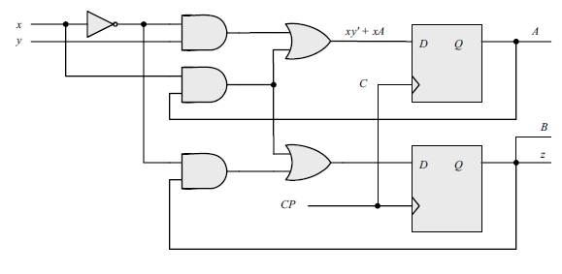
Practice

Slide 62
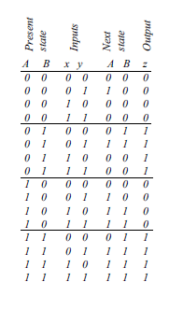
Practice

Slide 63
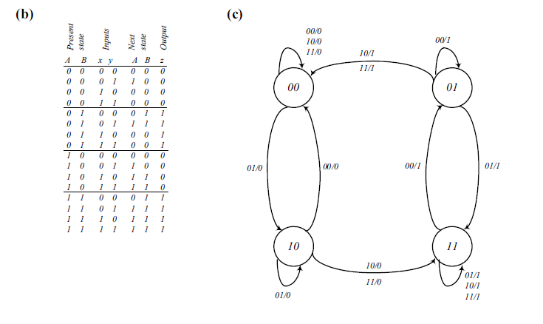
Practice

Slide 64
Mealy and Moore Models
The Mealy model: the outputs are functions of both the present state and inputs
The outputs may change if the inputs change during the clock pulse period.
The outputs may have momentary false values unless the inputs are synchronized with the clocks.
The Moore model: the outputs are functions of the present state only
The outputs are synchronous with the clocks.

Slide 65
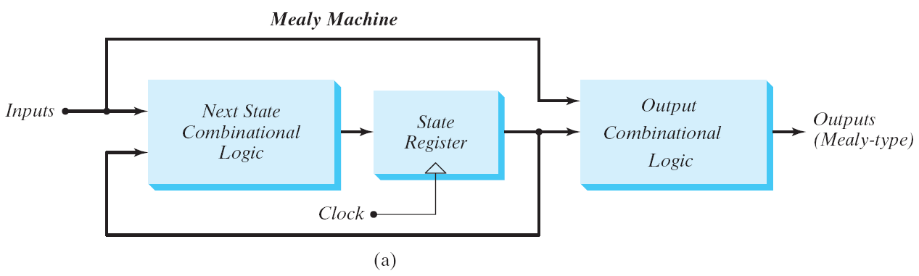
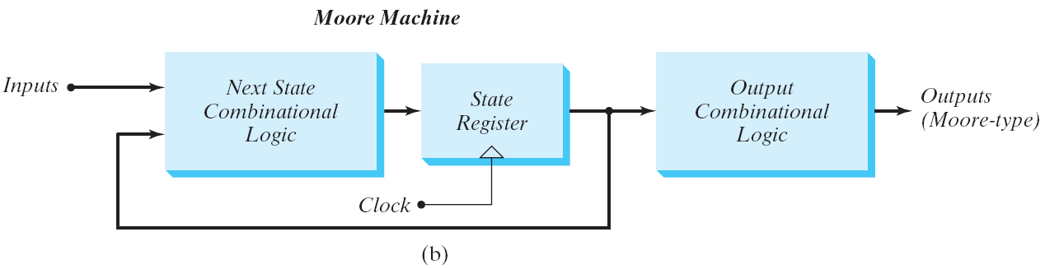
Mealy and Moore Models
Block diagram of Mealy and Moore state machine

Slide 66
Mealy and Moore Models
Mealy
Moore
Present State |  | I/P | Next State |  | O/P
A | B | x | A | B | y
0 | 0 | 0 | 0 | 0 | 0
0 | 0 | 1 | 0 | 1 | 0
0 | 1 | 0 | 0 | 0 | 1
0 | 1 | 1 | 1 | 1 | 0
1 | 0 | 0 | 0 | 0 | 1
1 | 0 | 1 | 1 | 0 | 0
1 | 1 | 0 | 0 | 0 | 1
1 | 1 | 1 | 1 | 0 | 0
Present State |  | I/P | Next State |  | O/P
A | B | x | A | B | y
0 | 0 | 0 | 0 | 0 | 0
0 | 0 | 1 | 0 | 1 | 0
0 | 1 | 0 | 0 | 1 | 0
0 | 1 | 1 | 1 | 0 | 0
1 | 0 | 0 | 1 | 0 | 0
1 | 0 | 1 | 1 | 1 | 0
1 | 1 | 0 | 1 | 1 | 1
1 | 1 | 1 | 0 | 0 | 1
For the same state, the output changes with the input
For the same state, the output does not change with the input

Slide 67
Moore State Diagram
State / Output
0
0
1
0 0 / 0
0 1 / 0
1
1
1 1 / 1
1 0 / 0
1
0
0

Slide 68
State reduction
Sequential circuit analysis
Circuit diagram state table (or state diagram)
Sequential circuit design
State diagram (state table) circuit diagram
Redundant state may exist in a state diagram (or table)
By eliminating them reduce the # of logic gates and flip-flops

Slide 69
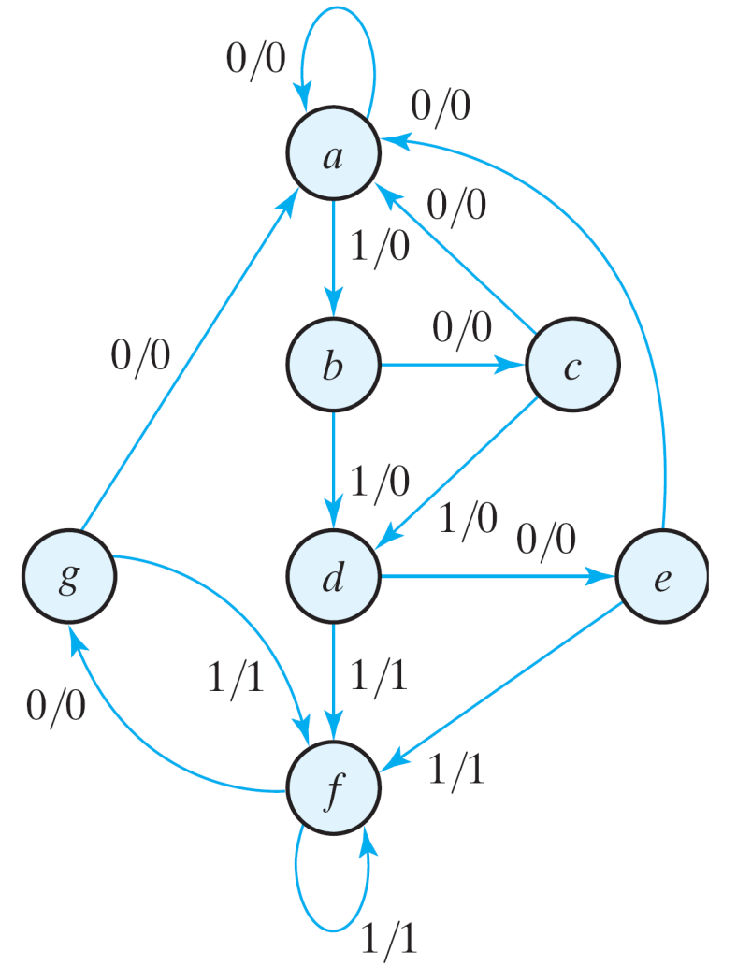
State Reduction
Initial State is a
State: | a | a | b | c | d | e | f | f | g | f | g | a
Input: | 0 | 1 | 0 | 1 | 0 | 1 | 1 | 0 | 1 | 0 | 0
Output: | 0 | 0 | 0 | 0 | 0 | 1 | 1 | 0 | 1 | 0 | 0
Only the input-output sequences are important.
Initial state is a
In state a, for input=0, output is 1, and next state is a
In state a, for input=1, output is 0, and next state is b
..and so on.
State diagram

Slide 70
State Reduction
Initial State is a
State: | a | a | b | c | d | e | f | f | g | f | g | a
Input: | 0 | 1 | 0 | 1 | 0 | 1 | 1 | 0 | 1 | 0 | 0
Output: | 0 | 0 | 0 | 0 | 0 | 1 | 1 | 0 | 1 | 0 | 0
Two circuits are equivalent
Have identical outputs for all input sequences;
The number of states is not important.
State diagram

Slide 71
State Reduction
Equivalent states
Two states are said to be equivalent
For each member of the set of inputs, they give exactly the same output and send the circuit to the same state or to an equivalent state.
One of them can be removed.

Slide 72
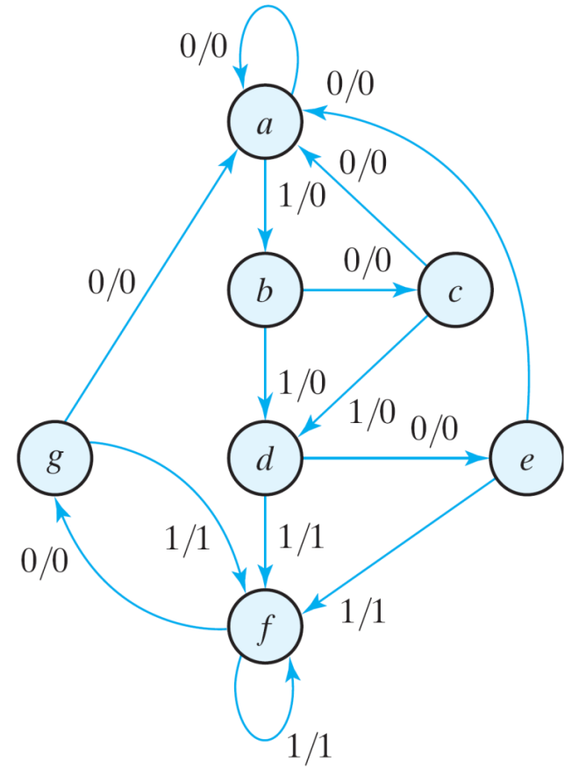
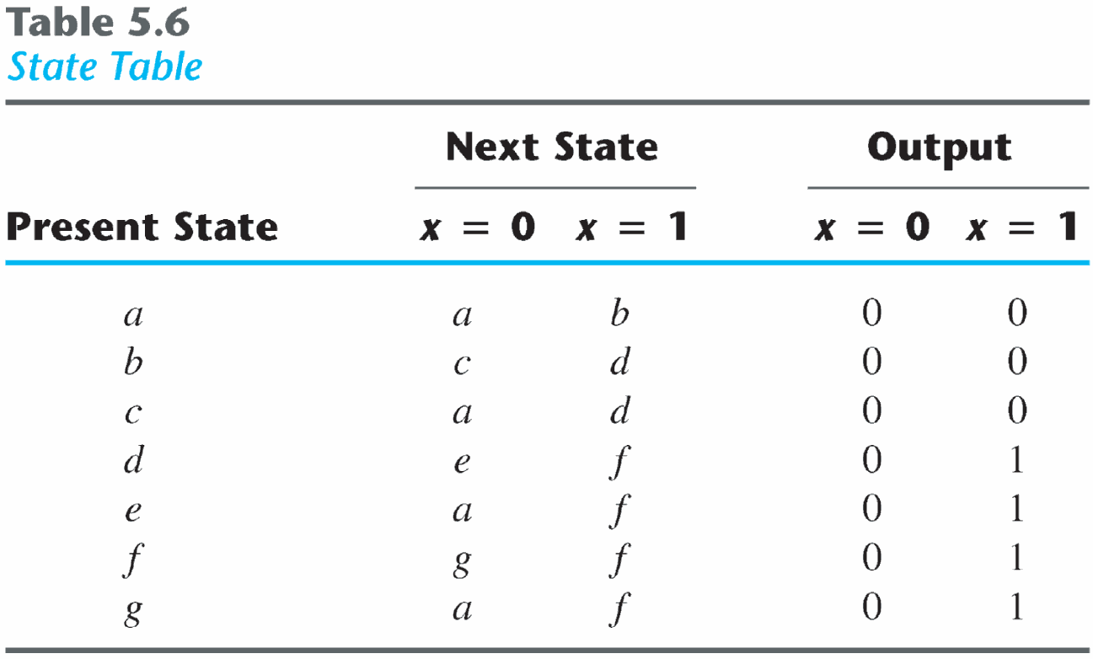
State Reduction
1. e = g (remove g);
2. Replace all g by e

Slide 73
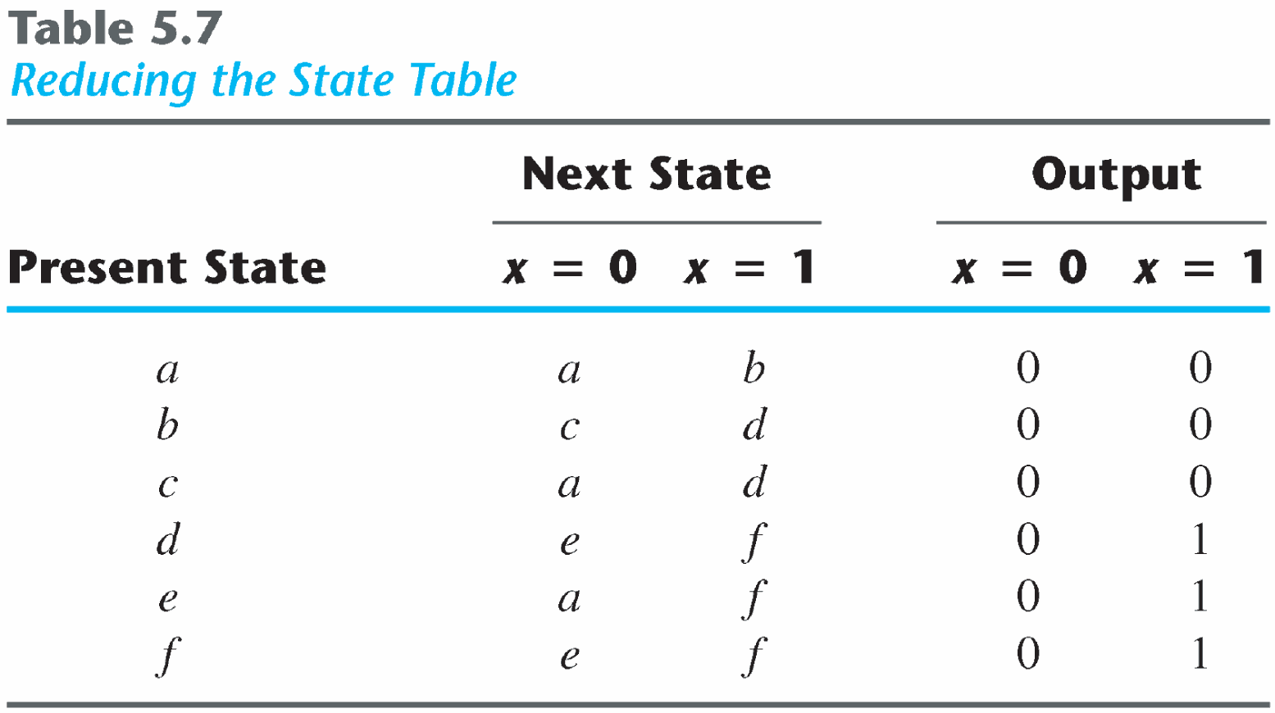
State Reduction
Reducing the state table
d = f (remove f);

Slide 74
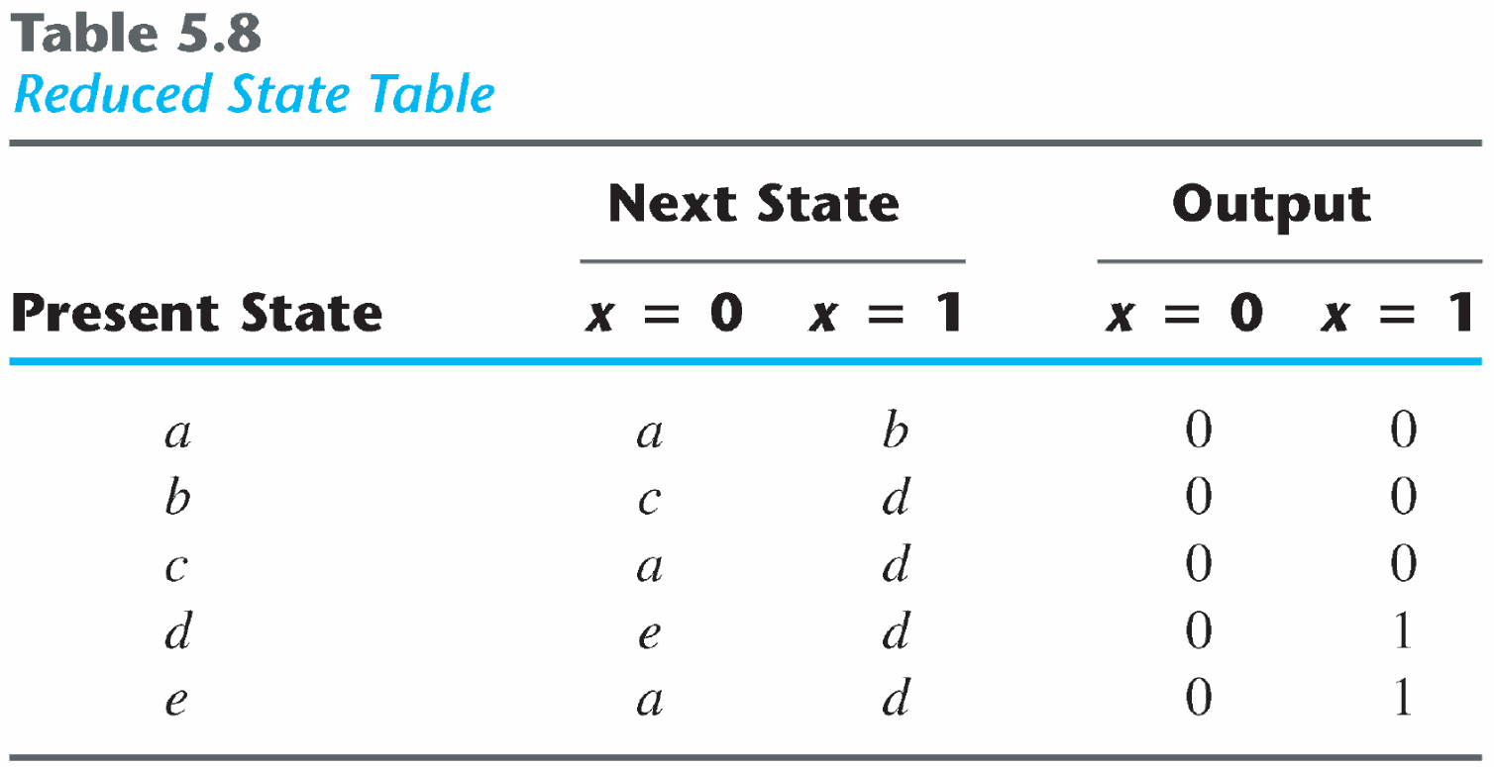
State Reduction
State: | a | a | b | c | d | e | d | d | e | d | e | a
Input: | 0 | 1 | 0 | 1 | 0 | 1 | 1 | 0 | 1 | 0 | 0
Output: | 0 | 0 | 0 | 0 | 0 | 1 | 1 | 0 | 1 | 0 | 0
The reduced finite state machine

Slide 75
State Reduction: Implication Table
The state-reduction procedure for completely specified state tables is based on the algorithm that two states in a state table can be combined into one if they can be shown to be equivalent.
There are occasions when a pair of states do not have the same next states, but, nonetheless, go to equivalent next states
The checking of each pair of states for possible equivalence in a table with a large number of states can be done systematically by means of an implication table.

Slide 76
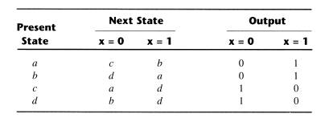
State Reduction: Implication Table
(a, b) imply (c, d) and (c, d) imply (a, b). Both pairs of states are equivalent; i.e., a and b are equivalent as well as c and d.

Slide 77
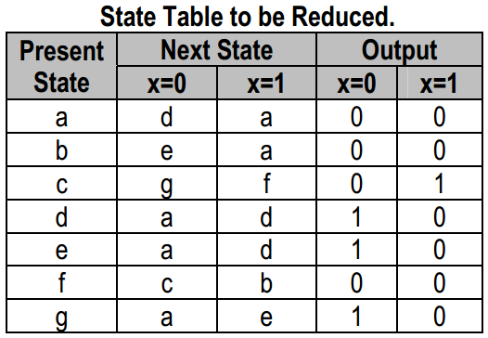
State Reduction:Implication Table

Slide 78
b
c
d
e
f
g
a | b | c | d | e | f
On the left side along the vertical are listed all the states defined in the state table except the first
across the bottom horizontally are listed all the states expect the last

Slide 79
b
c
d
e
f
g
d-e
d-e
a | b | c | d | e | f
we place a cross in any square corresponding to a pair of states whose outputs are not equal for every input.
we place a tick in any square corresponding to a pair of states whose outputs and next states are equal for every input.
Otherwise, we enter the pairs of states that are implied by the pair of states representing the squares.0

Slide 80
b
c
d
e
f
g
d-c a-b
c-e a-b
d-e
d-e
a | b | c | d | e | f

Slide 81
b
c
d
e
f
g
d-c a-b
c-e a-b
d-e
d-e
a | b | c | d | e | f

Slide 82
b
c
d
e
f
g
d-c a-b
c-e a-b
d-e
d-e
a | b | c | d | e | f

Slide 83
b
c
d
e
f
g
d-c a-b
c-e a-b
d-e
d-e
a | b | c | d | e | f

Slide 84
b
c
d
e
f
g
d-e
d-c a-b
c-e a-b
d-e
d-e
a | b | c | d | e | f

Slide 85
b
c
d
e
f
g
d-e
d-c a-b
c-e a-b
d-e
d-e
a | b | c | d | e | f
The next step is to make successive passes through the table to determine whether any additional squares should be marked with a cross or tick
A square in the table is crossed out if it contains at least one implied pair that is not equivalent

Slide 86
State Reduction: Implication Table
Finally, all the squares that have no crosses are recorded with check marks. The equivalent states are: (a, b), (d, e), (d, g), (e, g).
We now combine pairs of states into larger groups of equivalent states. The last three pairs can be combined into a set of three equivalent states (d, e, g) because each one of the states in the group is equivalent to the other two.

Slide 87
b
c
d
e
f
g
d-e
d-c a-b
c-e a-b
d-e
d-e
a | b | c | d | e | f

Slide 88
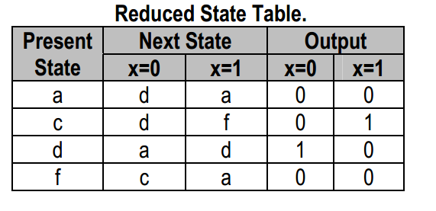
State Reduction: Implication Table
The final partition of these states consists of the equivalent states found from the implication table, together with all the remaining states in the state table that are not equivalent to any other state: (a, b) (c) (d, e, g) (f)

Slide 89
State Assignment
Assign coded binary values to the states for physical implementation
For a circuit with m states, the codes must contain n bits where 2^{n} >= m
Unused states are treated as don’t care conditions during the design
Don’t cares can help to obtain a simpler circuit
There are many possible state assignments
Have large impacts on the final circuit size

Slide 90
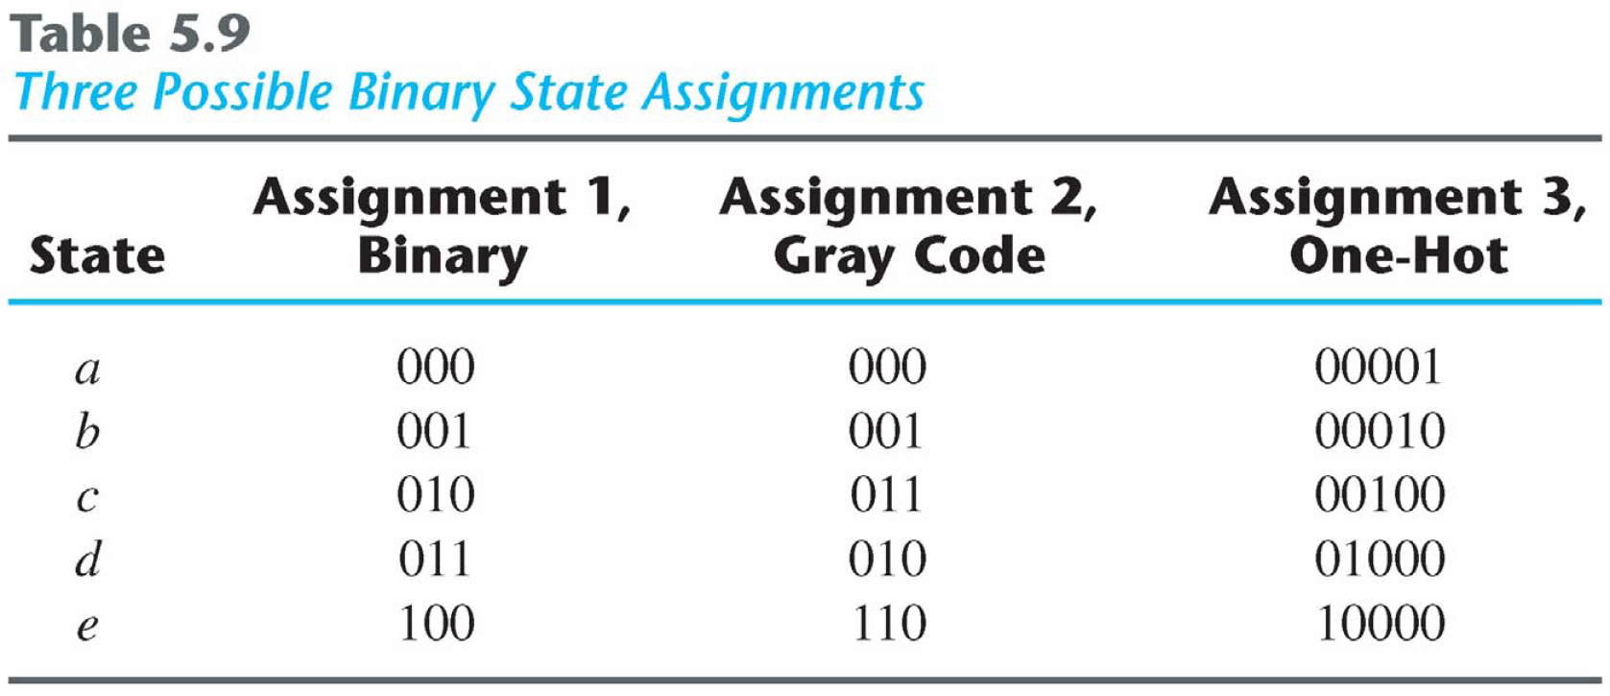
Popular State Assignment

Slide 91
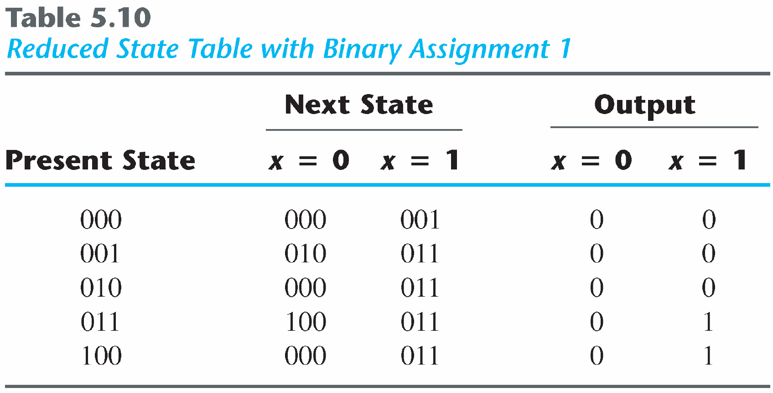
State Assignment
Any binary number assignment is satisfactory as long as each state is assigned a unique number
Use binary assignment 1

Slide 92
Design Procedure
Derive a state diagram for the circuit from specifications
Reduce the number of states if necessary
Assign binary values to the states
Obtain the binary-coded state table
Choose the type of flip-flop to be used
Derive the simplified flip-flop input equations and output equations
Draw the logic diagram

Slide 93
Design Procedure
Derive a state diagram for the circuit from specifications
Reduce the number of states if necessary
Assign binary values to the states
Obtain the binary-coded state table
Choose the type of flip-flop to be used
Derive the simplified flip-flop input equations and output equations
Draw the logic diagram

Slide 94
Design of Clocked Sequential Circuits
Example:
Detect 3 or more consecutive 1’s
0
1
S₀ / 0
S₁ / 0
State | A B
S₀ | 0 0
S₁ | 0 1
S₂ | 1 0
S₃ | 1 1
0
0
1
0
S₃ / 1
S₂ / 0
1
1

Slide 95
Design of Clocked Sequential Circuits
Example:
Detect 3 or more consecutive 1’s
Present State |  | Input | Next State |  | Output
A | B | x | A | B | y
0 | 0 | 0
0 | 0 | 1
0 | 1 | 0
0 | 1 | 1
1 | 0 | 0
1 | 0 | 1
1 | 1 | 0
1 | 1 | 1
0
1
S₀ / 0
S₁ / 0
0 0 0
0 1 0
0 0 0
1 0 0
0 0 0
1 1 0
0 0 1
1 1 1
0
0
1
0
S₃ / 1
S₂ / 0
1
1

Slide 96
Design of Clocked Sequential Circuits
Example:
Detect 3 or more consecutive 1’s
Present State |  | Input | Next State |  | Output
A | B | x | A | B | y
0 | 0 | 0
0 | 0 | 1
0 | 1 | 0
0 | 1 | 1
1 | 0 | 0
1 | 0 | 1
1 | 1 | 0
1 | 1 | 1
Synthesis using D Flip-Flops
0 0 0
0 1 0
0 0 0
1 0 0
0 0 0
1 1 0
0 0 1
1 1 1
A(t+1) = D_{A} (A, B, x)
= ∑ (3, 5, 7)
B(t+1) = D_{B} (A, B, x)
= ∑ (1, 5, 7)
y (A, B, x) = ∑ (6, 7)

Slide 97
Design of Clocked Sequential Circuits with D F.F.
Example:
Detect 3 or more consecutive 1’s
Synthesis using D Flip-Flops
 |  |  |  | B
 |  | 0 | 0 | 1 | 0
A |  | 0 | 1 | 1 | 0
 |  |  | x
D_{A} (A, B, x) = ∑ (3, 5, 7)
= A x + B x
D_{B} (A, B, x) = ∑ (1, 5, 7)
= A x + B’ x
y (A, B, x) = ∑ (6, 7)
= A B
 |  |  |  | B
 |  | 0 | 1 | 0 | 0
A |  | 0 | 1 | 1 | 0
 |  |  | x
 |  |  |  | B
 |  | 0 | 0 | 0 | 0
A |  | 0 | 0 | 1 | 1
 |  |  | x

Slide 98
Design of Clocked Sequential Circuits with D F.F.
Example:
Detect 3 or more consecutive 1’s
Synthesis using D Flip-Flops
D_{A} = A(t+1) = A x + B x
D_{B} = B(t+1)
= A x + B’ x
y = A B

Slide 99
Flip-Flop Excitation Tables
Present State | Next State | F.F. Input
Q(t) | Q(t+1) | J | K
0 | 0
0 | 1
1 | 0
1 | 1
0 x
1 x
x 1
x 0

Slide 100
Flip-Flop Excitation Tables
Present State | Next State | F.F. Input
Q(t) | Q(t+1) | D
0 | 0
0 | 1
1 | 0
1 | 1
Present State | Next State | F.F. Input
Q(t) | Q(t+1) | J | K
0 | 0
0 | 1
1 | 0
1 | 1
0 0 (No change)
0 1 (Reset)
0
1
0
1
0 x
1 x
x 1
x 0
1 0 (Set)
1 1 (Toggle)
0 1 (Reset)
1 1 (Toggle)
0 0 (No change)
1 0 (Set)
Q(t) | Q(t+1) | T
0 | 0
0 | 1
1 | 0
1 | 1
0
1
1
0

Slide 101
Design of Clocked Sequential Circuits with JK F.F.
Example:
Detect 3 or more consecutive 1’s
Present State |  | Input | Next State |  | Flip-Flop Inputs
A | B | x | A | B | J_{A} | K_{A} | J_{B} | K_{B}
0 | 0 | 0 | 0 | 0
0 | 0 | 1 | 0 | 1
0 | 1 | 0 | 0 | 0
0 | 1 | 1 | 1 | 0
1 | 0 | 0 | 0 | 0
1 | 0 | 1 | 1 | 1
1 | 1 | 0 | 0 | 0
1 | 1 | 1 | 1 | 1
Synthesis using JK F.F.
0 x
0 x
0 x
1 x
x 1
x 0
x 1
x 0
0 x
1 x
x 1
x 1
0 x
1 x
x 1
x 0
J_{A} (A, B, x) = ∑ (3)
d_{JA} (A, B, x) = ∑ (4,5,6,7)
K_{A} (A, B, x) = ∑ (4, 6)
d_{KA} (A, B, x) = ∑ (0,1,2,3)
J_{B} (A, B, x) = ∑ (1, 5)
d_{JB} (A, B, x) = ∑ (2,3,6,7)
K_{B} (A, B, x) = ∑ (2, 3, 6)
d_{KB} (A, B, x) = ∑ (0,1,4,5)

Slide 102
Design of Clocked Sequential Circuits with JK F.F.
Example:
Detect 3 or more consecutive 1’s
Synthesis using JK Flip-Flops
 |  |  |  | B
 |  | 0 | 0 | 1 | 0
A |  | x | x | x | x
 |  |  | x
 |  |  |  | B
 |  | x | x | x | x
A |  | 1 | 0 | 0 | 1
 |  |  | x
J_{A} = B x K_{A} = x’
J_{B} = x K_{B} = A’ + x’
 |  |  |  | B
 |  | 0 | 1 | x | x
A |  | 0 | 1 | x | x
 |  |  | x
 |  |  |  | B
 |  | x | x | 1 | 1
A |  | x | x | 0 | 1
 |  |  | x

Slide 103
Design of Clocked Sequential Circuits with T F.F.
Example:
Detect 3 or more consecutive 1’s
Present State |  | Input | Next State |  | F.F. Input
A | B | x | A | B | T_{A} T_{B}
0 | 0 | 0 | 0 | 0
0 | 0 | 1 | 0 | 1
0 | 1 | 0 | 0 | 0
0 | 1 | 1 | 1 | 0
1 | 0 | 0 | 0 | 0
1 | 0 | 1 | 1 | 1
1 | 1 | 0 | 0 | 0
1 | 1 | 1 | 1 | 1
Synthesis using T Flip-Flops
0
0
0
1
1
0
1
0
0
1
1
1
0
1
1
0
T_{A} (A, B, x) = ∑ (3, 4, 6)
T_{B} (A, B, x) = ∑ (1, 2, 3, 5, 6)

Slide 104
Design of Clocked Sequential Circuits with T F.F.
Example:
Detect 3 or more consecutive 1’s
Synthesis using T Flip-Flops
T_{A} = A x’ + A’ B x
T_{B} = A’ B + B ⊕ x
 |  |  |  | B
 |  | 0 | 0 | 1 | 0
A |  | 1 | 0 | 0 | 1
 |  |  | x
 |  |  |  | B
 |  | 0 | 1 | 1 | 1
A |  | 0 | 1 | 0 | 1
 |  |  | x

Slide 105
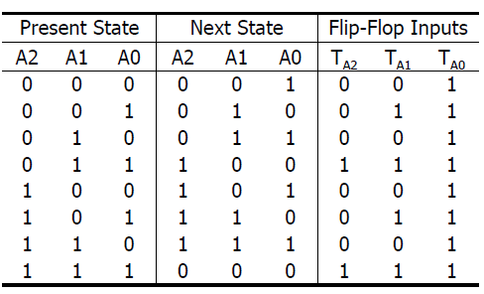
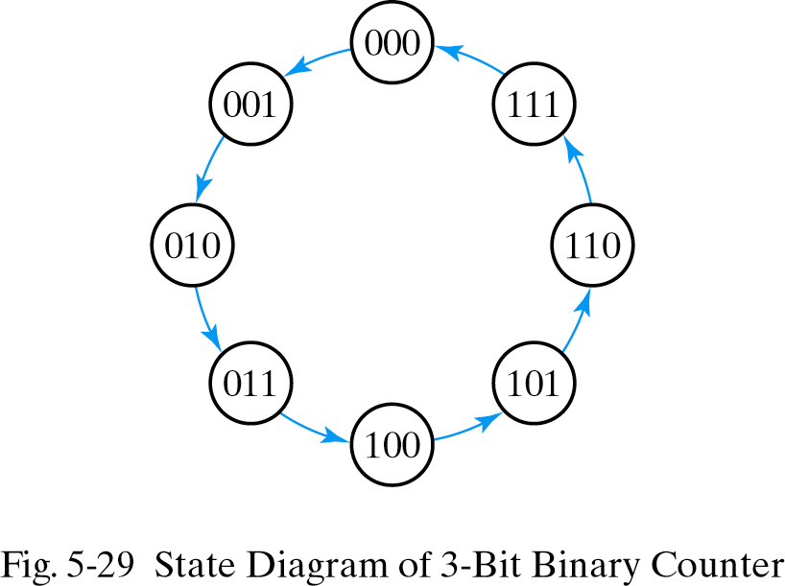
Design of Clocked Sequential Circuits with T F.F.
Example:
3-bit binary counter

Slide 106
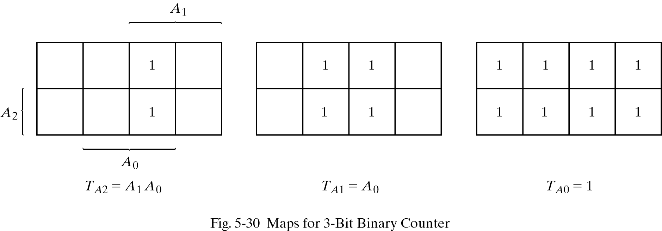
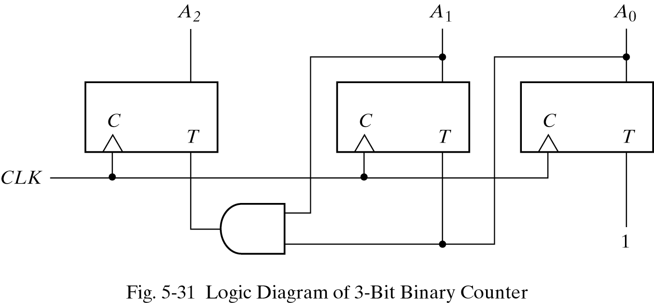
Design of Clocked Sequential Circuits with T F.F.

Slide 107
Design of Clocked Sequential Circuits with D F.F.
Design a one-input, one-output serial 2's complementer. The circuit accepts a string of bits from the input and generates the 2's complement at the output. The circuit can be reset asynchronously to start and end the operation.

Slide 108
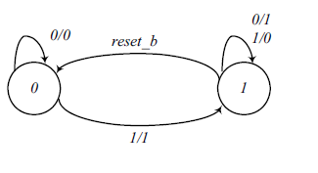
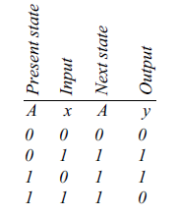

Design of Clocked Sequential Circuits with D F.F.

Slide 109
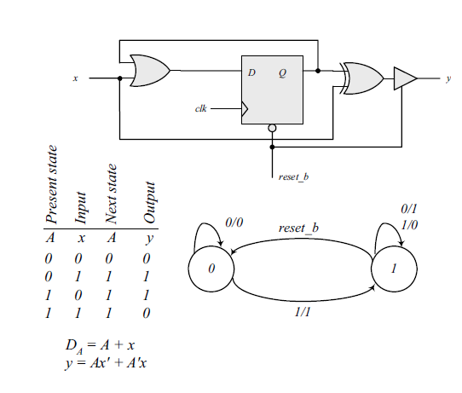
Design of Clocked Sequential Circuits with D F.F.

